Slide 1

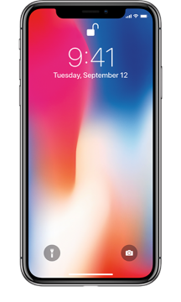


Apple & Samsung slowing down phones
Group 13
Shuolin Hu
Abhinav Choudhary
Yufan Gao
Zhijun Yu
Rishik Kumar Katam

Slide 2



Background
Shuolin Hu

Slide 3
2017: iPhone users report slowed-down devices after updates
Accusations: Apple intentionally slows older iPhones to push upgrades
Debate: Controversy sparks debate on planned obsolescence
Ethical Concerns: Transparency, consumer trust, and fair business practices
Notes:
The controversy around Apple slowing down older iPhones started in 2017, when iPhone users noticed that their devices were running slower than usual after updating to the latest iOS software. Some users also reported that their iPhones were shutting down unexpectedly, even when the battery appeared to have plenty of charge remaining.
In response to these reports, Apple released a statement acknowledging that it had implemented software updates that could slow down older iPhones with aging batteries. Apple stated that the updates were designed to prevent unexpected shutdowns, which could occur when the battery was unable to provide enough power to support the iPhone's performance demands.
Apple's admission sparked outrage among many iPhone users, who accused the company of deliberately slowing down older iPhones to encourage users to upgrade to newer models. Some users also pointed out that Apple had not been transparent about the software updates, leading many to believe that their iPhones were simply becoming obsolete.
The tech giant issued a rare statement of explanation on Thursday, saying that it has used software updates to limit the performance of older iPhones that may have battery issues that would cause them to turn off suddenly.
Tech analysts and angry customers have reported in recent days that operating system updates had caused older iPhones to slow considerably, with some suggesting that Apple could be using the tactic to encourage fans to buy new phones.
Apple insists the updates were made with a different goal in mind: It said the performance of lithium-ion batteries degrades over time, which can sometimes cause phones to suddenly shut down in order to protect their components.
The company said its software updates for the iPhone 6, iPhone 6S, iPhone SE and iPhone 7 are designed to "smooth out" peak power demands, prevent these surprise shutdowns and ultimately prolong the lifespan of batteries.
But the updates can also lead to disappointing speeds.
Doron Myersdorf, CEO instant-charging battery startup StoreDot, said that "smoothing out" means that phones will reorder incoming commands to make sure not all of them are done in parallel. "The inevitable outcome of it will be an inherent slowdown of the average response times by the system," he explained.
Apple (AAPL) said in its statement that it will continue to use the feature with other products in the future. "Our goal is to deliver the best experience for customers, which includes overall performance and prolonging the life of their devices," it said.
The revelation sparked an outcry among Apple fans, with some suggesting they may switch to rival Samsung.
"Since Apple admits they slow down old iPhones I'll admit I probably won't buy a new iPhone," said Twitter user Jeff Zenisek.
-- Samuel Burke contributed reporting.
CNNMoney (London)First published December 21, 2017: 7:26 AM ET

Slide 4
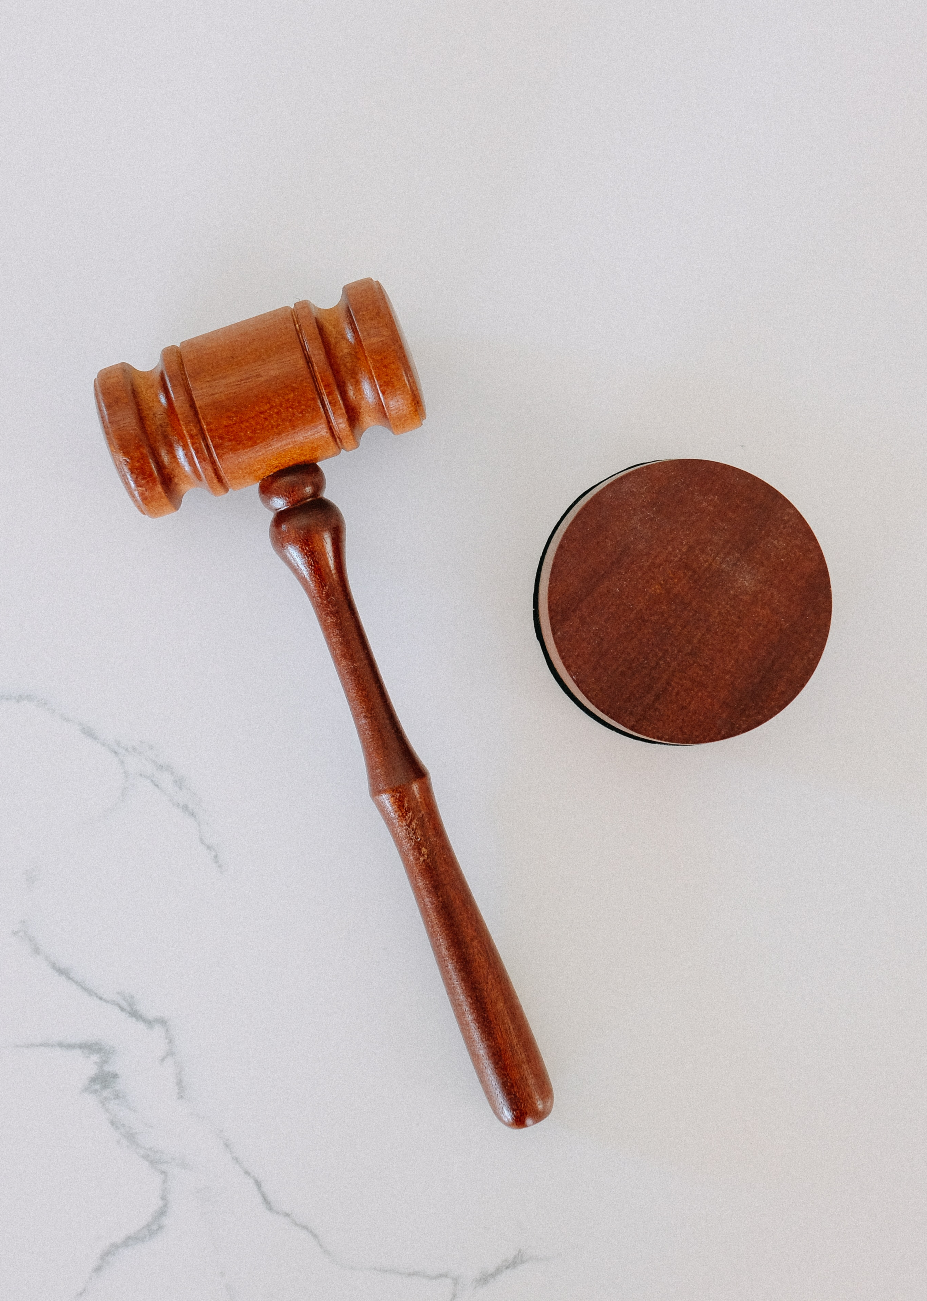




Court Cases & Regulatory
Actions
Abhinav Choudhary

Slide 5

Class Action Lawsuit
The class-action lawsuit against Apple was filed in December 2017 in the United States District Court for the Northern District of California.
The lawsuit was brought by a group of iPhone users, who alleged Apple’s actions were designed to force users to upgrade to newer models.
The lawsuit sought compensation, more transparency about its software updates, and affordable options for battery replacement.
The lawsuit was eventually settled in March 2020, with Apple agreeing to pay $113 million to affected iPhone users.
The settlement also required Apple to provide more transparent information about iPhone battery health and performance, and to offer more affordable options for iPhone battery replacements.
Notes:
The class-action lawsuit against Apple was filed in December 2017 in the United States District Court for the Northern District of California. The lawsuit was brought by a group of iPhone users who claimed that Apple had violated consumer protection laws by intentionally slowing down older iPhones without their knowledge or consent.
The lawsuit alleged that Apple's actions were designed to force users to upgrade to newer iPhone models, which would generate more revenue for the company. The plaintiffs claimed that Apple's lack of transparency about the software updates misled users into believing that their iPhones were faulty or outdated, and caused them to spend money on unnecessary upgrades.
The lawsuit sought compensation for affected iPhone users, as well as a court order requiring Apple to stop slowing down older iPhones without user consent. The lawsuit also sought to force Apple to provide more transparency about its software updates, and to offer more affordable options for iPhone battery replacements.
The lawsuit gained significant media attention, and sparked a broader public debate about the ethics of planned obsolescence in the technology industry. Many users expressed frustration at the perceived lack of control over their devices, and called for greater transparency and accountability from technology companies.
The lawsuit was eventually settled in March 2021, with Apple agreeing to pay $113 million to affected iPhone users. The settlement also required Apple to provide more transparent information about iPhone battery health and performance, and to offer more affordable options for iPhone battery replacements. While the settlement did not require Apple to admit wrongdoing, it represented a significant victory for iPhone users who had been affected by the controversy.

Slide 6

Italian Competition Authority (AGCM)
In January 2018, the Italian Competition Authority or AGCM announced that it had launched an investigation into Apple's practices. Investigation focused on whether Apple had violated Italy's consumer protection laws.
In December 2018, fined Apple and Samsung 5 million euros (about $5.7 million) each for releasing software updates that "significantly reduced" the performance of phones, the AGCM said in a statement.
Both companies urged people to install updates that weren't "adequately supported by their devices," the AGCM said. Adding that Apple and Samsung failed to provide customers with an "effective way to recover the full functionality of their devices."
Apple was fined an additional 5 million euros for allegedly failing to provide adequate information on how to maintain and replace phone batteries.
Notes:
The class-action lawsuit against Apple was filed in December 2017 in the United States District Court for the Northern District of California. The lawsuit was brought by a group of iPhone users who claimed that Apple had violated consumer protection laws by intentionally slowing down older iPhones without their knowledge or consent.
The lawsuit alleged that Apple's actions were designed to force users to upgrade to newer iPhone models, which would generate more revenue for the company. The plaintiffs claimed that Apple's lack of transparency about the software updates misled users into believing that their iPhones were faulty or outdated, and caused them to spend money on unnecessary upgrades.
The lawsuit sought compensation for affected iPhone users, as well as a court order requiring Apple to stop slowing down older iPhones without user consent. The lawsuit also sought to force Apple to provide more transparency about its software updates, and to offer more affordable options for iPhone battery replacements.
The lawsuit gained significant media attention, and sparked a broader public debate about the ethics of planned obsolescence in the technology industry. Many users expressed frustration at the perceived lack of control over their devices, and called for greater transparency and accountability from technology companies.
The lawsuit was eventually settled in March 2021, with Apple agreeing to pay $113 million to affected iPhone users. The settlement also required Apple to provide more transparent information about iPhone battery health and performance, and to offer more affordable options for iPhone battery replacements. While the settlement did not require Apple to admit wrongdoing, it represented a significant victory for iPhone users who had been affected by the controversy.

Slide 7


Apple &
Samsung’s
Response
Rishik Kumar Katam

Slide 8
In December, Apple acknowledged that iOS slows down the performance of older iPhones. An action done to counteract problems in aging lithium-ion batteries.
After facing criticism, Apple formally apologized and offered battery replacements for $29, which was set to end on December 31st .
Apple denied that the slowdown was intended to push customers to buy new models.
Samsung denied slowing down phones and said it will appeal the decision.
Both Apple and Samsung were ordered to publish a declaration on their Italian websites informing consumers about the decision.
Samsung claimed that it did not issue any software updates that reduced the Galaxy Note 4's performance. Adding that Samsung has always released software updates enabling customers to have the best experience possible.
Notes:
Last December, Apple acknowledged that its iOS software slows down the performance of older iPhonesapologized formally end Dec. 31. The company says iOS does this to counteract problems in aging lithium-ion batteries. After facing criticism over its battery policies, Apple and offered battery replacements for $29, a program set to .
Apple has denied that phones were slowed in order to get customers to buy new models. The company didn't respond to a request for comment.
Samsung denied it slowed down phones and said it will appeal the decision.
"We are disappointed with the Italian Competition Authority ... decision," a Samsung spokesperson said in an email statement. "Samsung did not issue any software update that reduced the Galaxy Note 4's performance. In contrast, Samsung has always released software updates enabling our customers to have the best experience possible."
Both smartphone makers were also ordered to publish a declaration on the Italian page of their websites informing consumers about the AGCM's decision.

Slide 9

Key Learnings & Takeaways
Zhijun Yu & Yufan Gao

Slide 10
Be Transparent
The Apple’s case of slowing down the older iPhones without telling its customers truth encourages us to think deeply about the ethical issues.
Practice: Apple hid the fact that that the system updates would dramatically degrade the performance, which was questioned for indirectly forcing the customers to buy the newly released iPhones.
Hazard: Apple misled the customers and consequently lost goodwill. In the long run, it will be less competitive, and its market share will be snatched by its competitors.
Right Approach: An ethically sound and responsible company shall ensure the services it provides to be sufficiently open and transparent. Those companies that are truthful about their services and the corresponding effects will be more likely to gain trust from customers. In this case, the Apple shall inform its customers of the side-effects of the system updates upon the updates were released. In this way, customers could make their choices comfortably on whether to update their systems according to their own situation.
Notes:
The ethical issue at the center of the controversy surrounding Apple's practice of slowing down older iPhones was the company's lack of transparency and the perceived deception of its customers. Many users felt that Apple had intentionally slowed down their devices without informing them, and that the company had encouraged them to purchase new devices rather than addressing the underlying issue.
This issue raises broader questions about the ethics of planned obsolescence, which refers to the practice of designing products with a limited lifespan in order to encourage consumers to purchase newer models. While planned obsolescence can be a legitimate business strategy, it can also be seen as unethical if it is designed to intentionally deceive or exploit consumers.
One key learning from the Apple case is the importance of transparency and honesty in business practices. Companies that are upfront about the performance of their products and the impact of software updates on device performance are more likely to build trust with their customers and avoid damaging controversies like the one that Apple faced.
Another key learning is the importance of consumer protection laws and regulatory oversight in ensuring that companies are held accountable for their actions. In the case of Apple, both the class-action lawsuit and the fine levied by the Italian Competition Authority served as important checks on the company's practices and highlighted the need for greater transparency and consumer protections in the technology industry.
Overall, the Apple controversy serves as a reminder that companies have a responsibility to act ethically and transparently, and that consumers have a right to expect honesty and fairness in the products and services that they purchase.

Slide 11
Importance of Consumer Protection Laws
Apple initially intended to hide the unethical practice of "reduce the performance of phones by releasing software updates".
It exactly was this concealment that outraged consumers, led technical analysts and professionals to investigate and eventually led to the AGCM's intervention and the imposition of fines.
So, Another key learning is the importance of consumer protection laws and regulatory oversight in ensuring that companies are held accountable for their actions. In the case of Apple, both the class-action lawsuit and the fine levied by the Italian Competition Authority served as important checks on the company's practices and highlighted the need for greater transparency and consumer protections in the technology industry.
Overall, the Apple and Samsung controversy serves as a reminder that companies have a responsibility to act ethically and transparently, and that consumers have a right to expect honesty and fairness in the products and services that they purchase.
Notes:
The ethical issue at the center of the controversy surrounding Apple's practice of slowing down older iPhones was the company's lack of transparency and the perceived deception of its customers. Many users felt that Apple had intentionally slowed down their devices without informing them, and that the company had encouraged them to purchase new devices rather than addressing the underlying issue.
This issue raises broader questions about the ethics of planned obsolescence, which refers to the practice of designing products with a limited lifespan in order to encourage consumers to purchase newer models. While planned obsolescence can be a legitimate business strategy, it can also be seen as unethical if it is designed to intentionally deceive or exploit consumers.
One key learning from the Apple case is the importance of transparency and honesty in business practices. Companies that are upfront about the performance of their products and the impact of software updates on device performance are more likely to build trust with their customers and avoid damaging controversies like the one that Apple faced.
Another key learning is the importance of consumer protection laws and regulatory oversight in ensuring that companies are held accountable for their actions. In the case of Apple, both the class-action lawsuit and the fine levied by the Italian Competition Authority served as important checks on the company's practices and highlighted the need for greater transparency and consumer protections in the technology industry.
Overall, the Apple controversy serves as a reminder that companies have a responsibility to act ethically and transparently, and that consumers have a right to expect honesty and fairness in the products and services that they purchase.

Slide 12

Thank You
Credits:
Presentation template from Slidesgo
Images from Unsplash

